Slide 1

Smart Device Usage Analysis: Understanding User Behavior and Trends

Slide 2
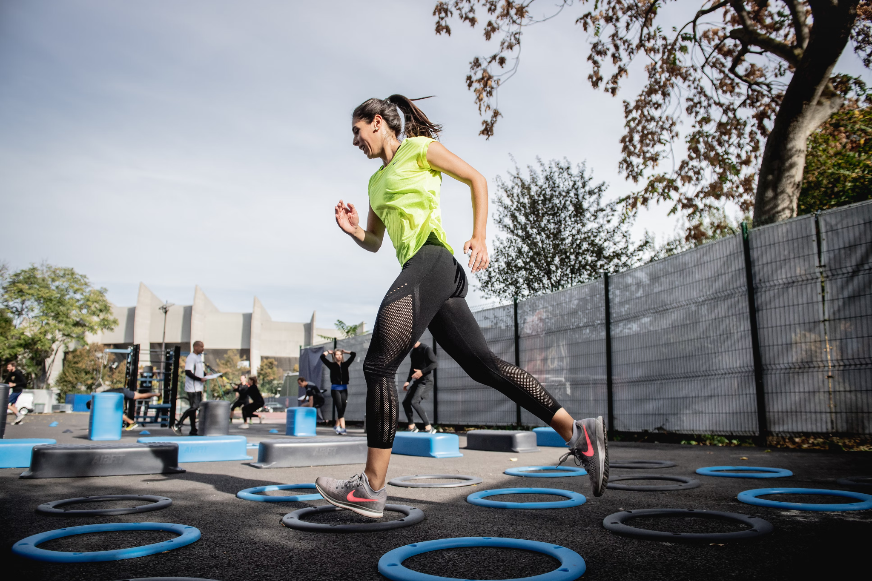
Goal
Develop better understanding of customer behaviour and health-related smart device usage trends
Customized marketing and personalized communication to retain existing customers and acquire new ones

Slide 3

Understanding Customer Insights
Usage Patterns and Customer Segmentation
How do our users use their devices?
What are observable trends?
How can we adapt our strategies and user experience accordingly?

Slide 4
Data Source Overview
Dataset: "FitBit Fitness Tracker Data: Pattern Recognition with Tracker Data - Improve Your Overall Health"
Source: Provided by Möbius on Kaggle
License: CC0
Data: Minute-level outputs of physical activity, heart rate, sleep monitoring over 31 days
Users: Data from thirty eligible Fitbit users
The dataset encompasses a wide range of metrics, such as physical activity levels, distance covered, time spent in different activity intensities, and calorie expenditure.
Because FitBit is worn on the wrist these insights will be most applicable to Bellabeat Time users.

Slide 5
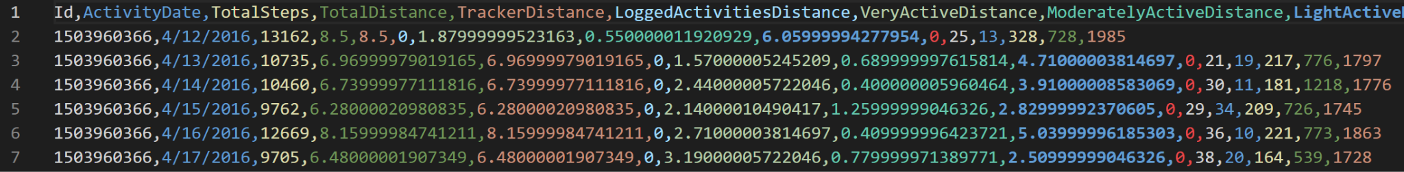
Workflow - Data assessment and cleaning
Assessment of data structure
Data distribution
Cleaning of missing data and nonsensical outliers

Slide 6
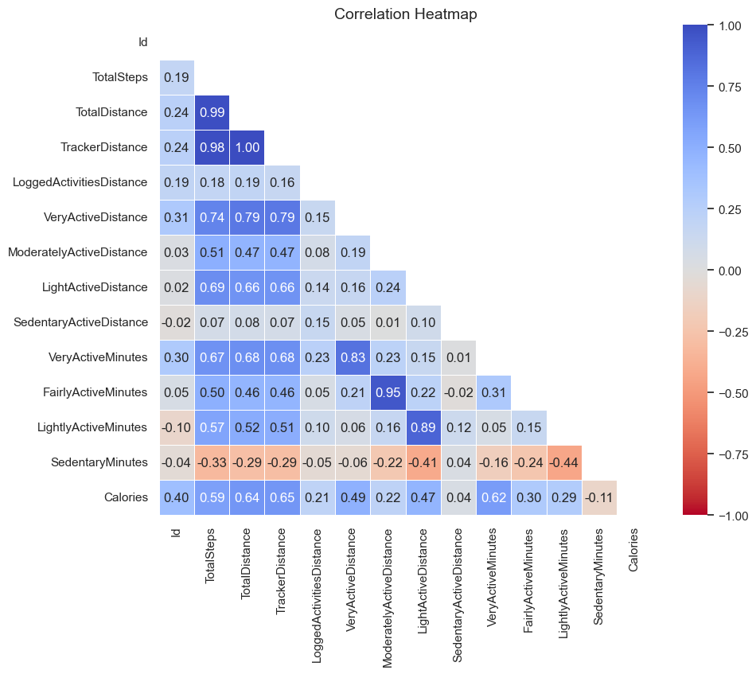
Workflow - Exploratory Data Analysis (EDA)
Feature correlation
How do features interact with each other? What does that tell us about our users and how can we use this for further analysis.

Slide 7
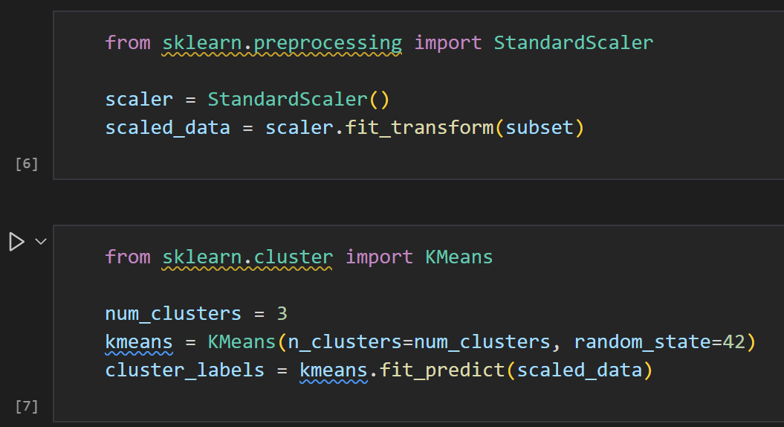
Workflow - Clustering
Data was scaled using the scikit-learn StandardScaler to prepare for clustering.
Scaled data was clustered using the K-means clustering algorithm with K=3 to separate users into 3 distinct groups.

Slide 8
General Insights
Majority of users are only lightly active.
Average sleep around 7 hours per night.
Average daily step count: 7,638. Slightly below the health-recommended threshold (8,000 steps).
Many in industrialized countries lead sedentary lifestyles, a concern for public health.
We should encourage increased physical activity to combat health risks.

Slide 9
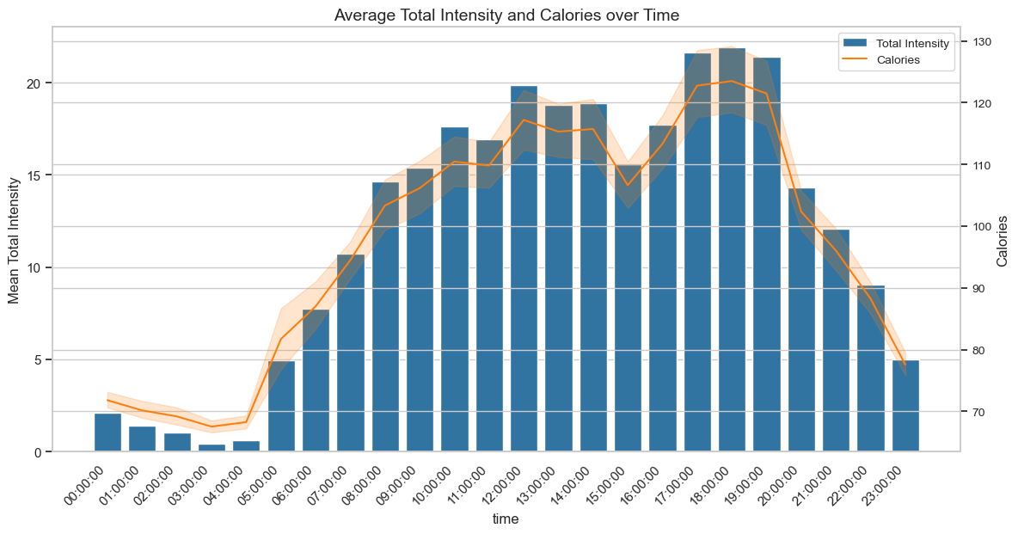
Most activity happens between 5 am and 11 pm, with peaks around 5 pm and 7 pm. This indicates, that people got off work and go to the gym or other activities. We can also nicely see how intensities and calories correlate which each other.
Sending notifications to promote physical activity during this time might be an effective approach to motivate people.

Slide 10
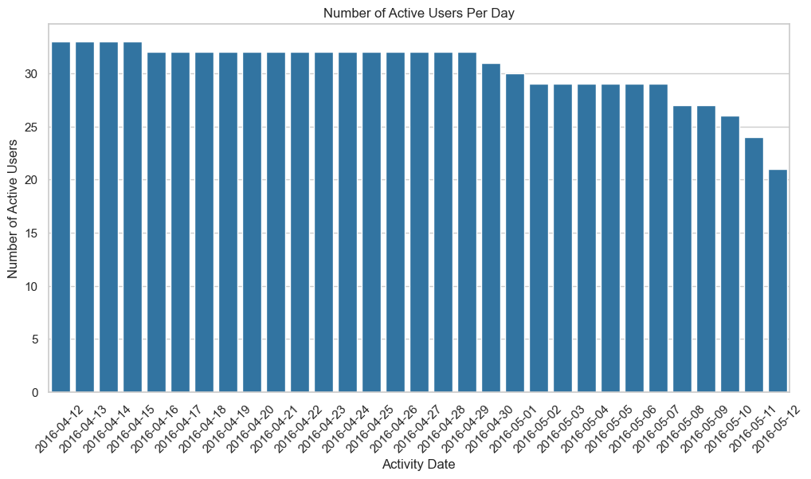
As can be seen, at the beginning of data collection, all 33 users used the app on a daily basis. However, this usage steadily decreased over time.
Motivating users to use the devices and app each day via streaks and ranking systems could enhance engagement levels.

Slide 11
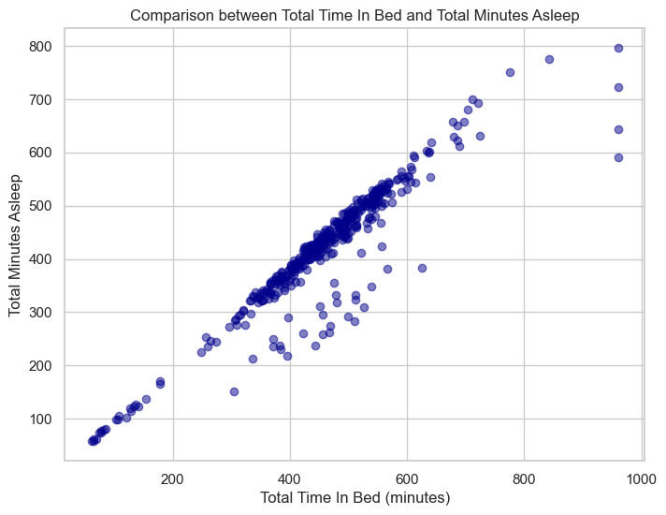
Clear correlation between time spent in bed and total minutes asleep. Outliers suggest bed usage without actual sleep.
Encourage bed use solely for sleep to enhance sleep quality and improve sleep patterns.
A key step in achieving quality sleep is designating the bed exclusively for sleep, considering the right environment and habits.

Slide 12
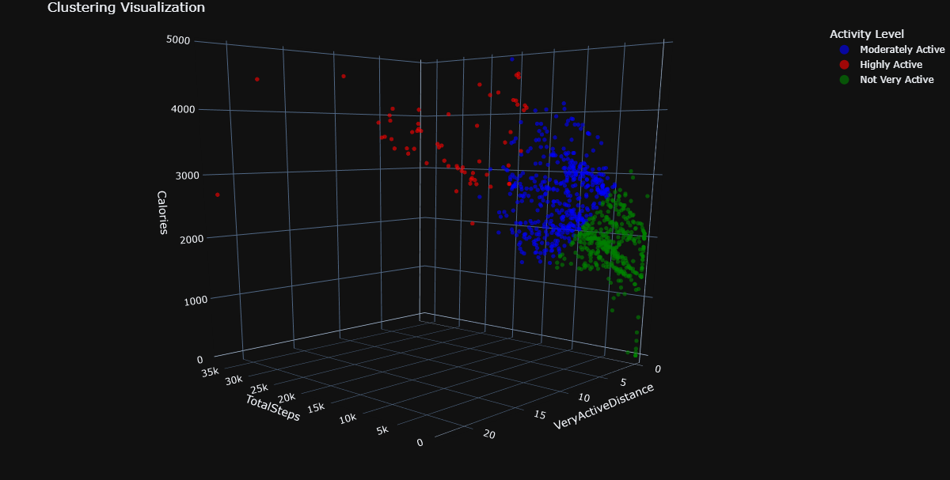
K-means Clustering approach
Clustering users based on 3 features TotalSteps, VeryActiveDistance, Calories which were chosen based on their respective correlation coefficients.
This clustering model can be used to assign users to one of three groups and give recommendations accordingly.

Slide 13
Key Insights and Actions
Sending notifications to promote physical activity in the early evening might be an effective approach to encourage physical activity.
Motivating users to use the devices and app each day via streaks and ranking systems could enhance engagement levels.
Encourage bed use solely for sleep to enhance sleep quality and improve sleep patterns.
This clustering model can be used to assign users to one of three groups and give recommendations accordingly.
More data from female users should be acquired to help gather better insights and increase modeling accuracy.

